Slide 1
DEPARTMENT OF BUSINESS, ECONOMIC DEVELOPMENT & TOURISM (DBEDT)
(SBRRB)
No. 1 Capitol District Building, 250 S. Hotel Street, Honolulu, HI 96813

Slide 2
Hawaii Legislature Creates SBRRB
Created- 1998 Hawaii’s Small Business Regulatory Flexibility Act went into effect - based on the 1980 federal Act and created Chapter 201M, HRS.
Purview – Review Hawaii Administrative Rules (HAR) that impact Hawaii “Small Businesses” for both State and County Agencies
Small Business – Defined as “for profit” companies with fewer than 100 full- and/or part-time employees

Slide 3
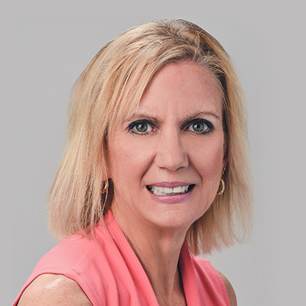
SBRRB TEAM
Dori Palcovich
-SBRRB Administrator
Jet’aime Ariola
-Program Specialist

Slide 4
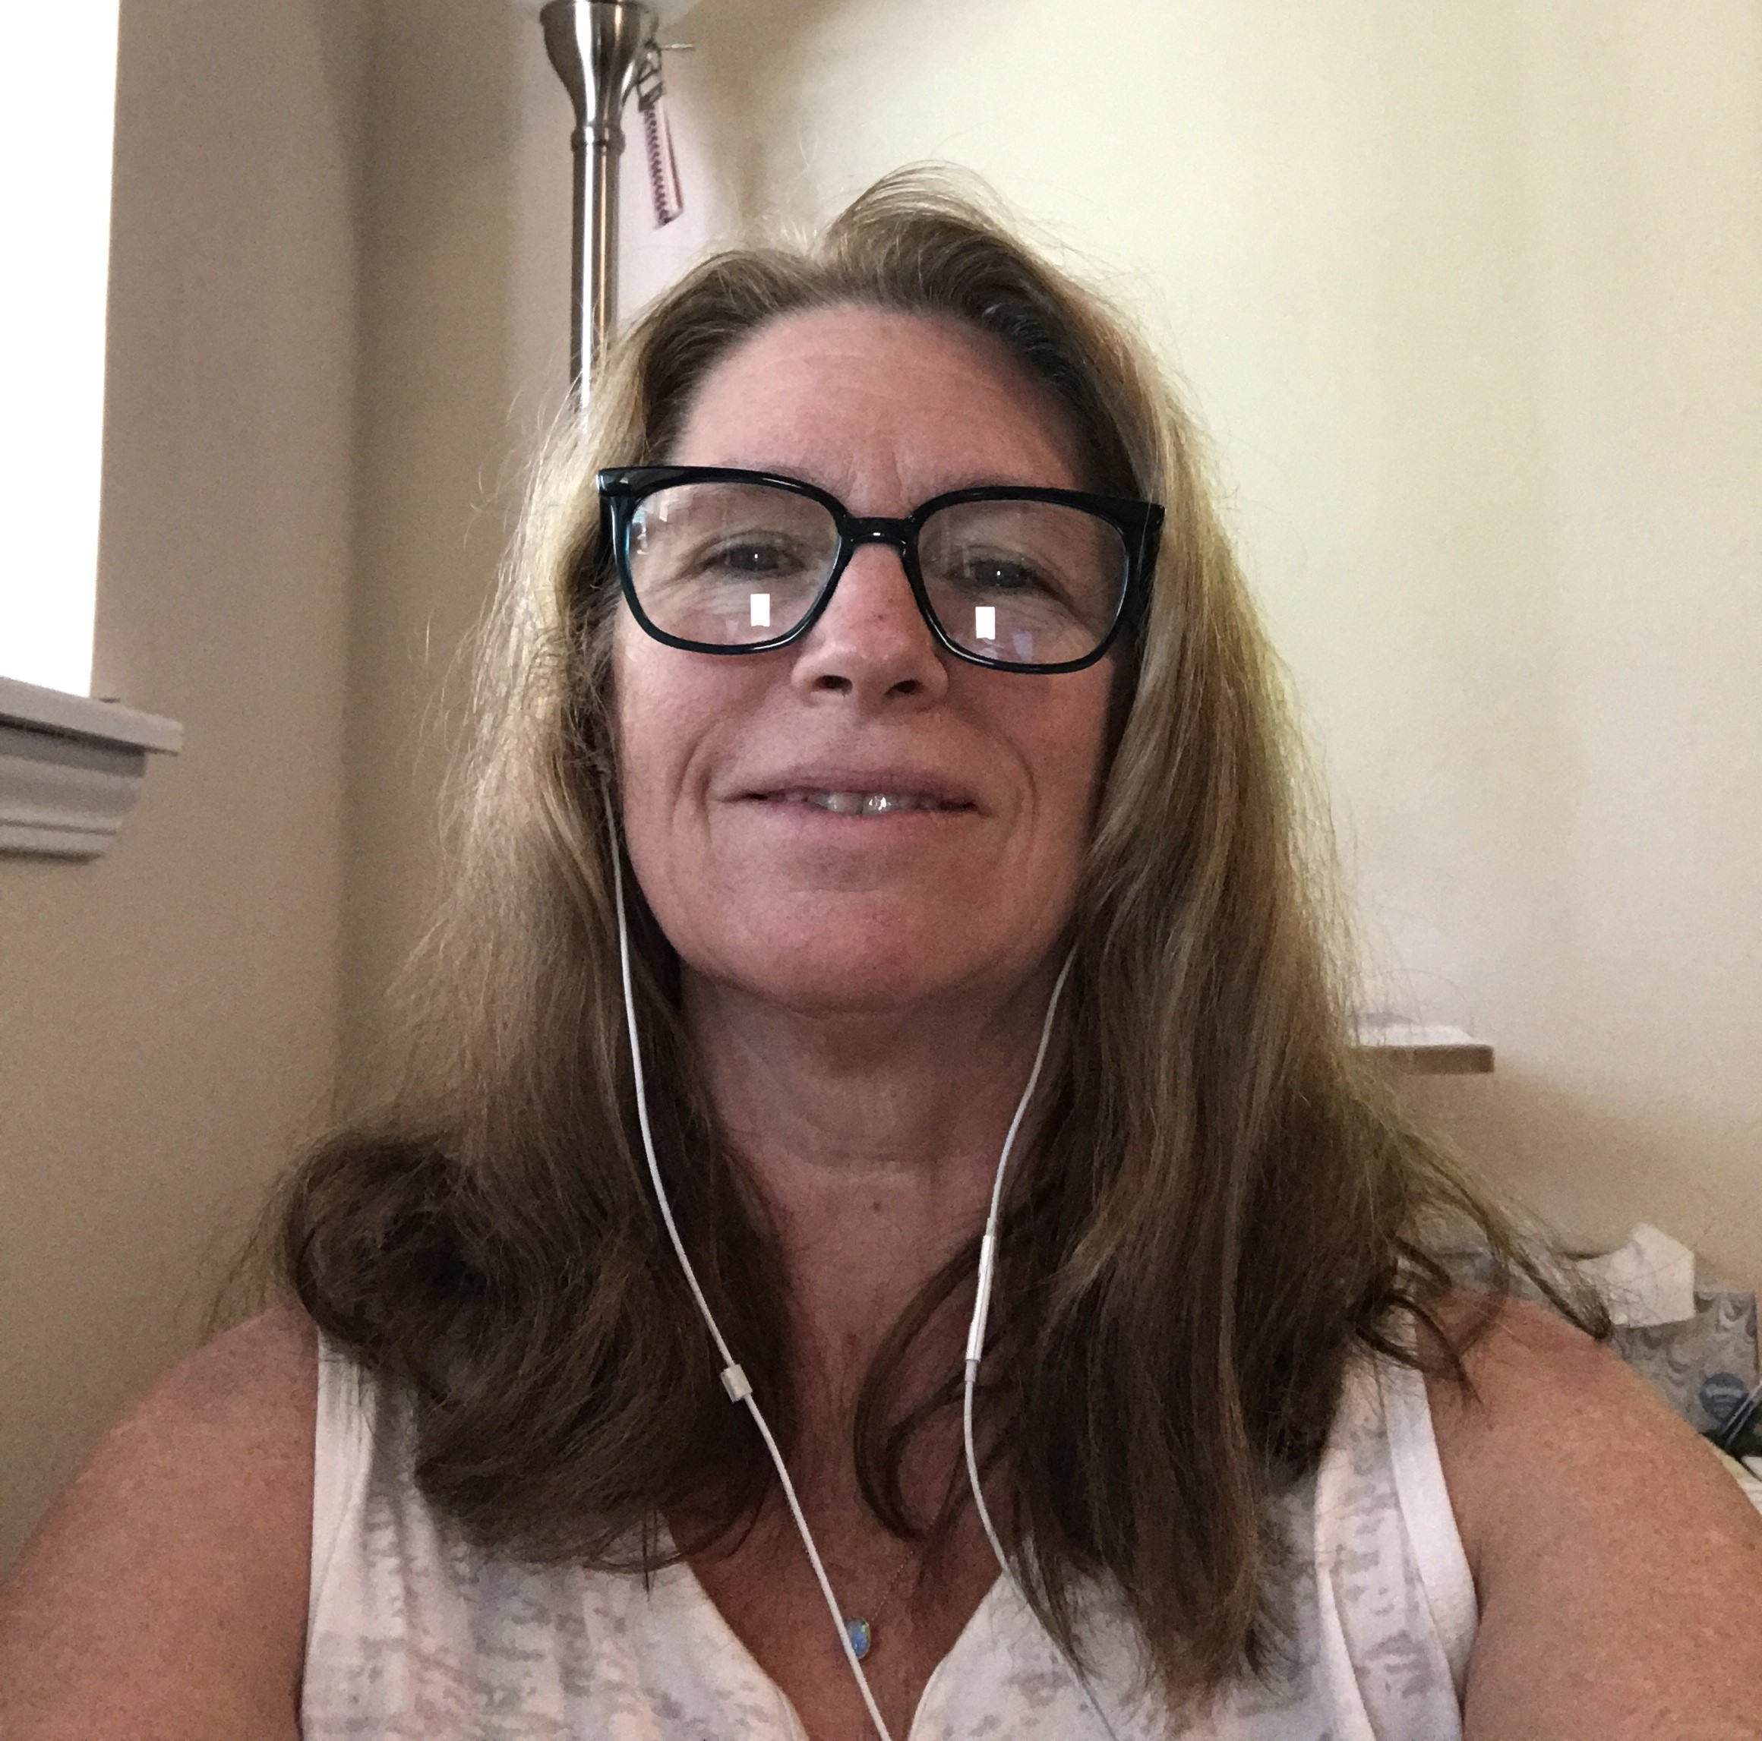
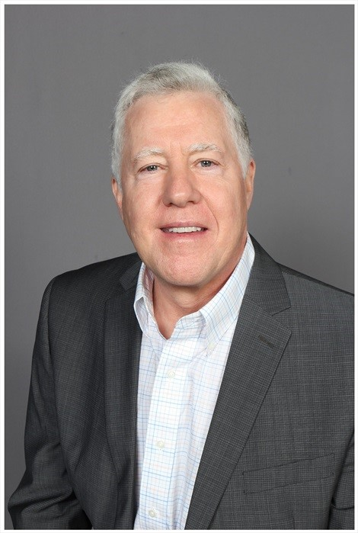
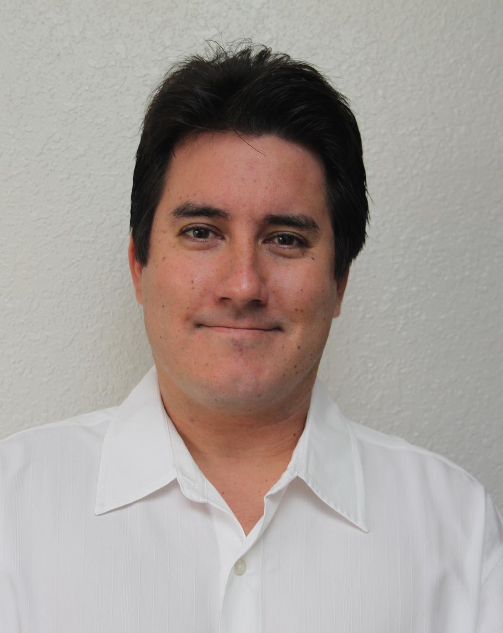
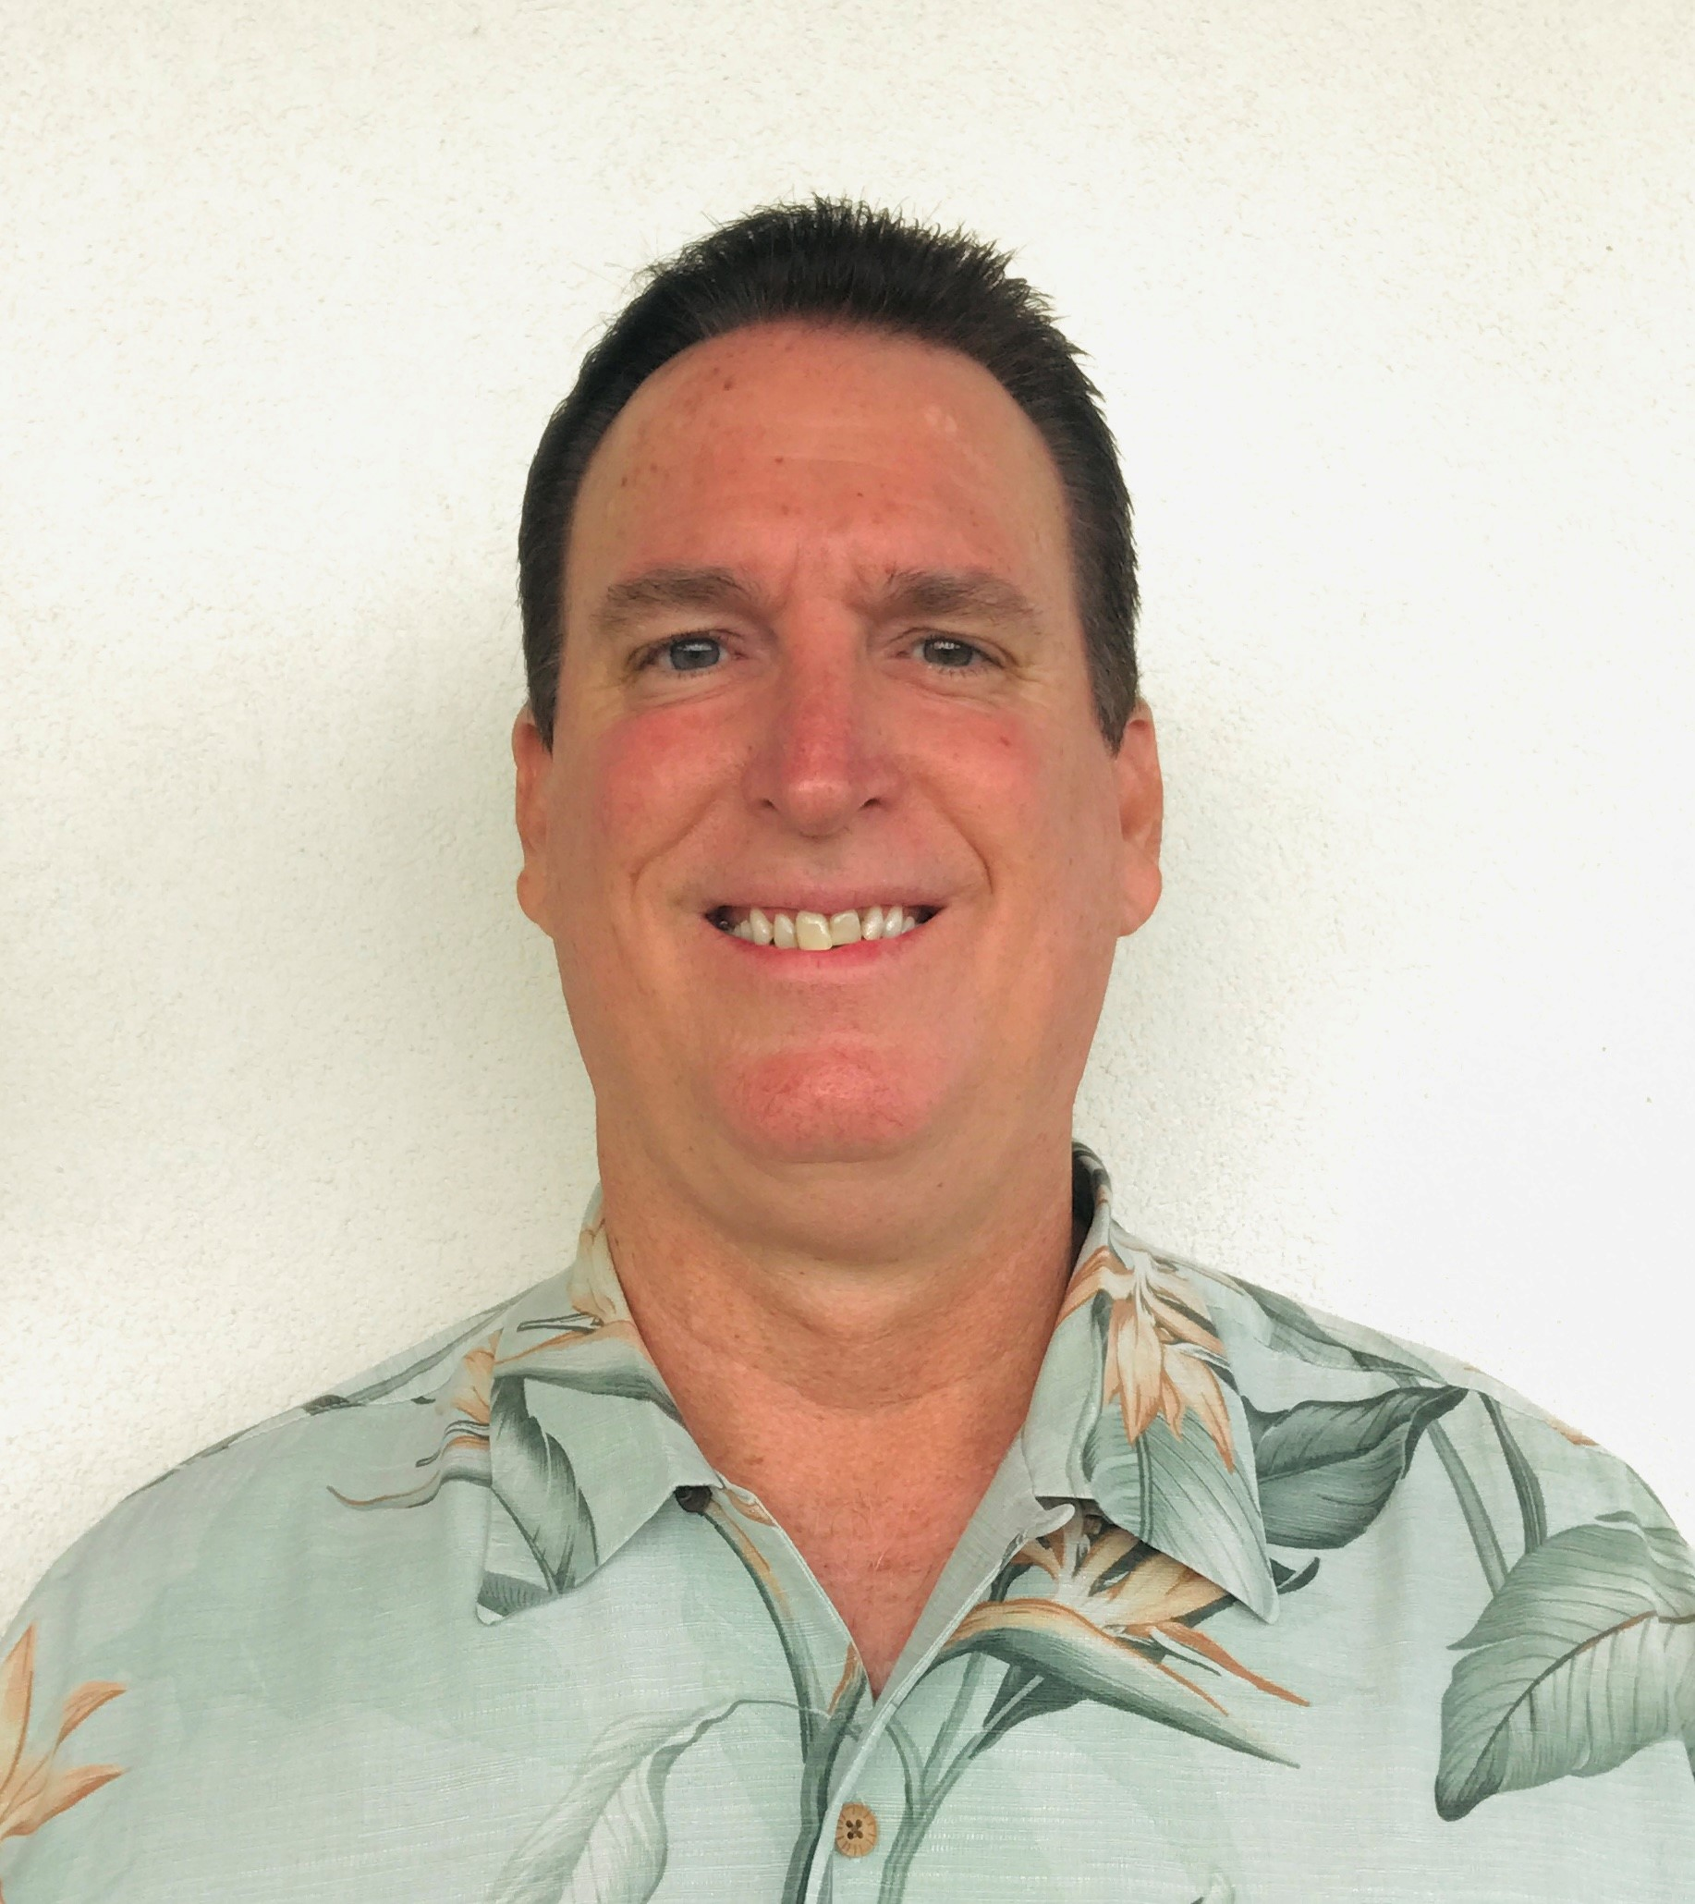
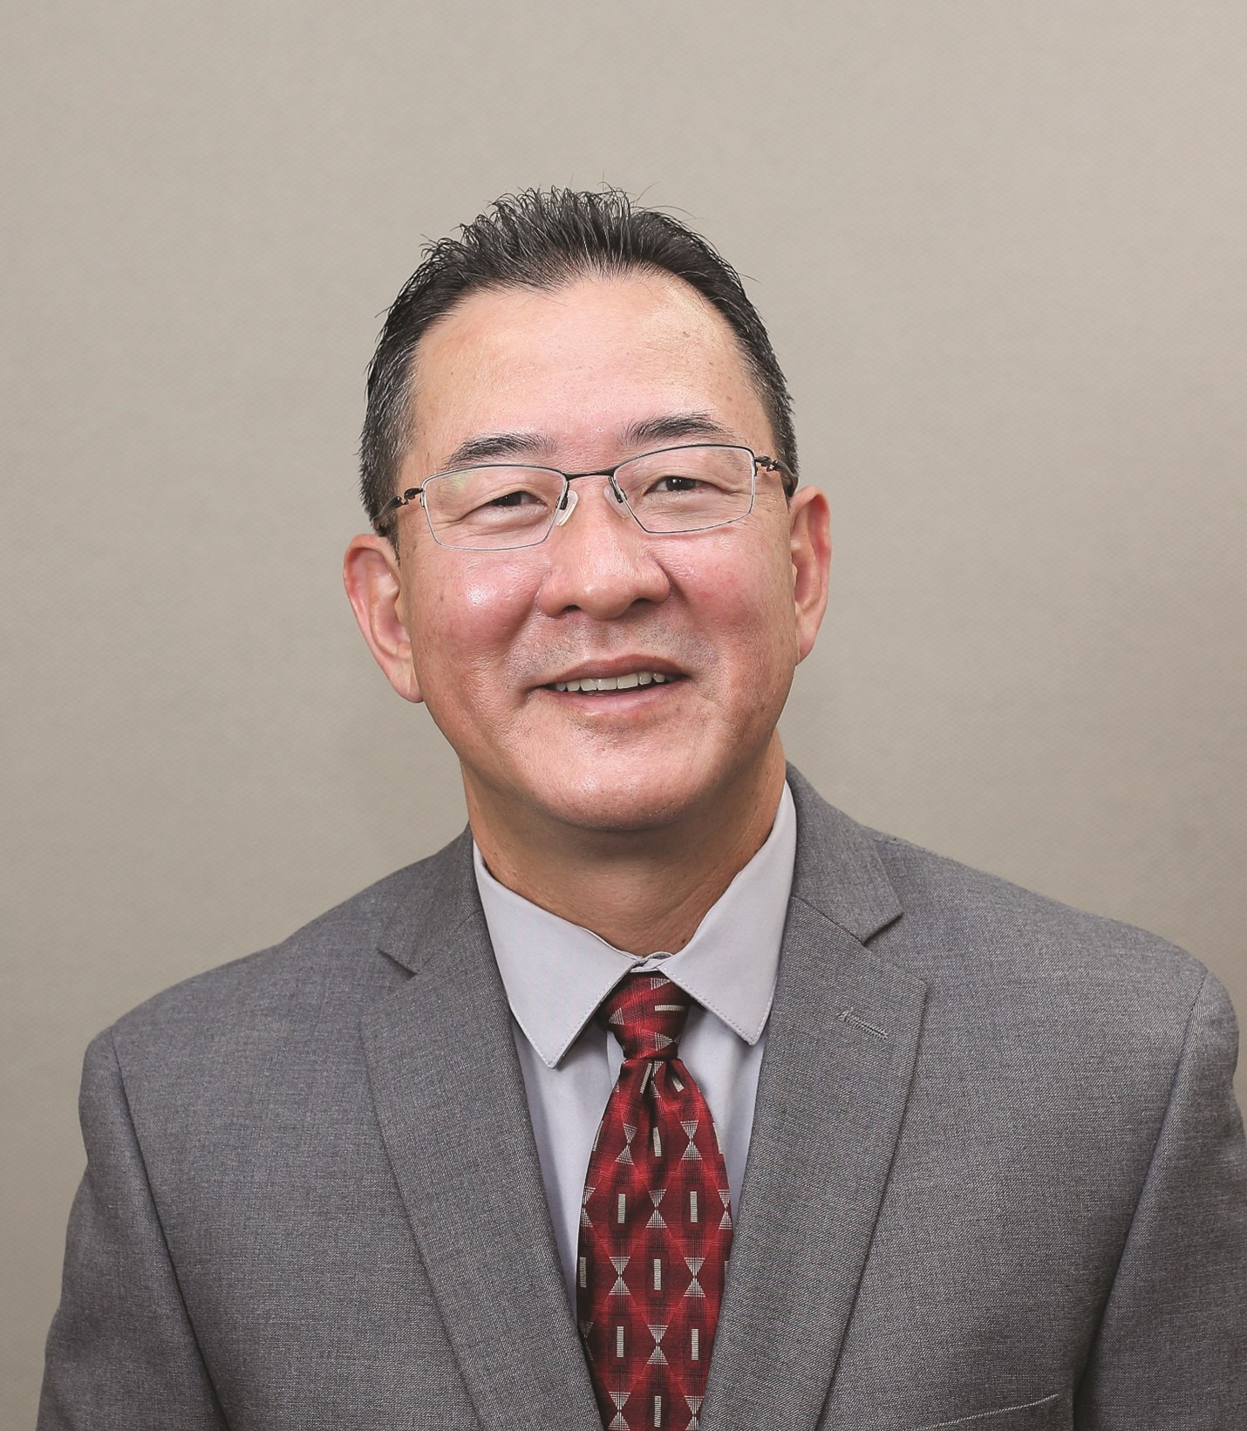
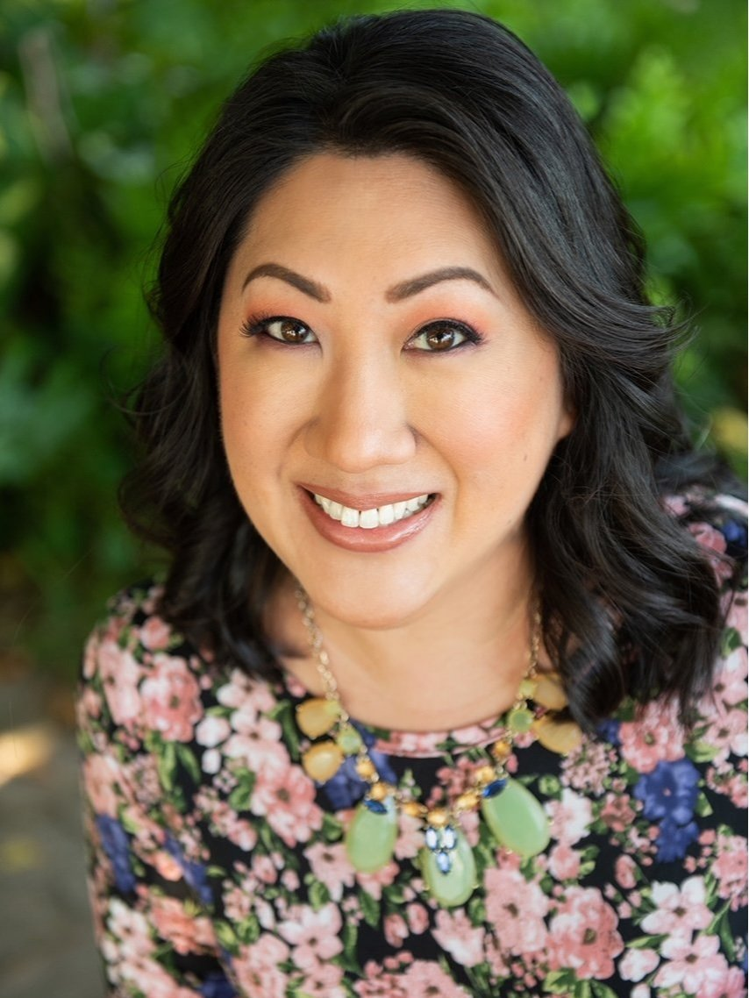
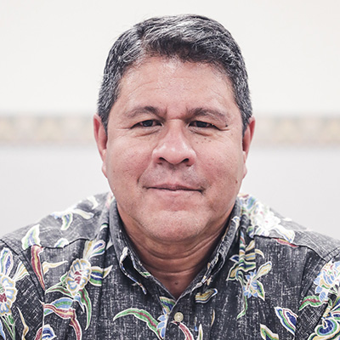
SBRRB MEMBERS
Jonathan Shick
Chair
City & County of Honolulu
Mary Albitz
Vice Chair
Maui County
Mark Ritchie
DBEDT Director Designated Representative
Nicolle Ige
Kaua’i County
Garth Yamanaka
Hawai’i County
Robert Cundiff
City & County of Honolulu
Sanford Morioka
Second Vice Chair
City & County of Honolulu
Tessa Gomes
City & County of Honolulu
Dr. Jennifer Salisbury
Maui County
James Kimo Lee, Jr.
Hawai’i County

Slide 5
SBRRB’s Vision and Mission
Vision
Mission
Make Hawai’i the most business-friendly state in the nation
Work toward a regulatory environment that encourages & supports the vitality of small business in Hawai’i

Slide 6
2023 Results
1) Reviewed & Commented on 45 State & County Rules – before and after public hearing / 1,053 total rules since inception
2) Received several Requests through the “Regulation for Review”
3) Outreach - Letters / Brochures / Cold Calling
- Becker Communications – Social Media / Youtube Video, etc.

Slide 7
How to CONTACT the SBRRB
https://sbrrb.hawaii.gov/
DBEDT.sbrrb.info@hawaii.gov
(808) 798-0737
Visit Monthly SBRRB meetings
Currently, meetings are hybrid via Zoom and at Leiopapa A Kamehameha Building – State Office Tower 235 Beretania Street, Conference Room 405 Honolulu, Hawaii 96813
@SBRRBHI

Slide 8
On Behalf of The Small Business Regulatory Review Board

