Slide 1
Small Business Regulatory Review Board (SBRRB)
Department of Business, Economic Development and Tourism

Slide 2
How was the SBRRB established?
Created- 1980 U.S. Congress passed the Regulatory Flexibility Act (RFA)
Purpose- Ensure regulators do not burden small businesses disproportionately by imposing uniform regulations on all entitles, regardless of size.
Created- 1998 Hawaii’s Small Business Regulatory Flexibility Act went into effect based on the federal act by creating Chapter 201M HRS.

Slide 3
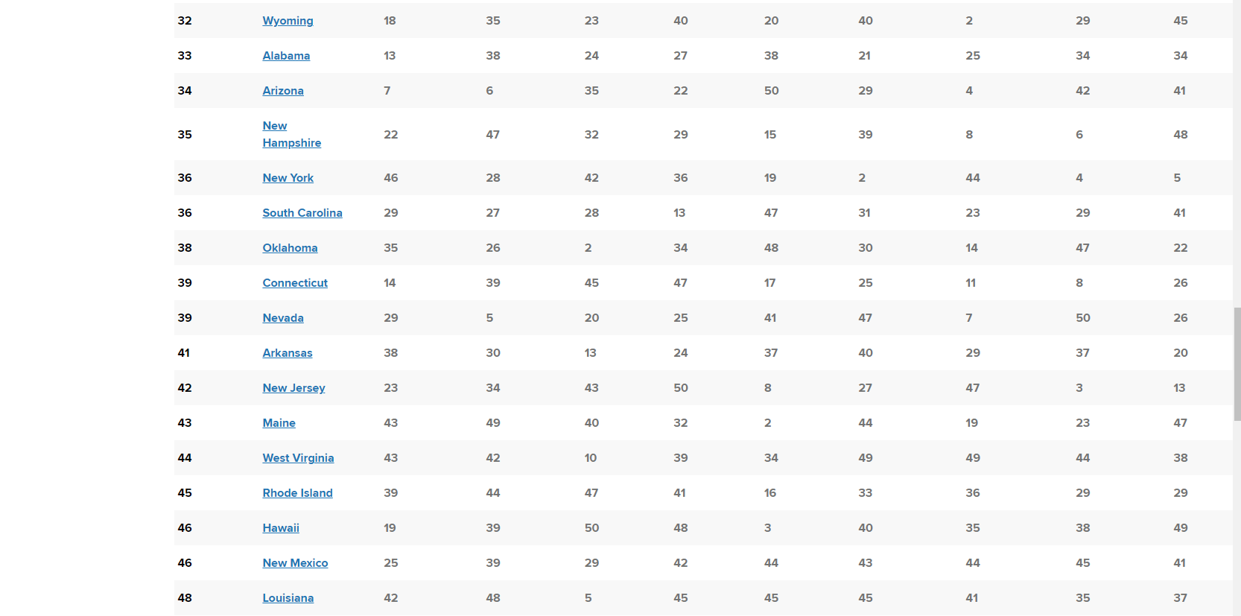

Slide 5
SBRRB’s Vision and Mission
Vision
Mission
Make Hawai’i the most business-friendly state in the nation
Work toward a regulatory environment that encourages & supports the vitality of small business in Hawai’i

Slide 6
What does the SBRRB do?
Chapter 201M, HRS created SBRRB:
Advocates for “for-profit” small business & entrepreneurs
Small business defined as a “for profit” “with fewer than 100 FT/PT employees,” Section 201M-1, HRS
Authority to comment, make recommendations on small business regulations & administrative rules

Slide 7
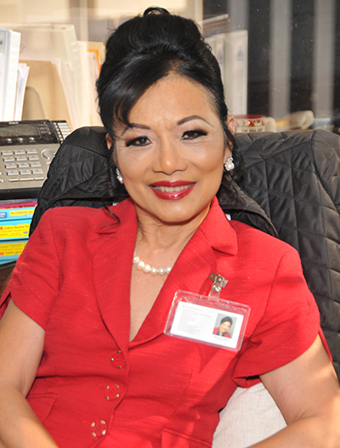
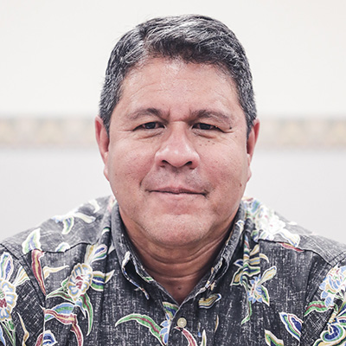
BOARD MEMBERS
DBEDT Staff:
Dori Palcovich
Jetaime Ariola
Mary Albitz
Chair
Maui County
Mark Ritchie
DBEDT Director Designated Representative
Jonathan Shick
Second Vice Chair
City & County of Honolulu
William Lydgate
Kaua’i County
Garth Yamanaka
Hawai’i County
Sanford Morioka
City & County of Honolulu
Dr. Nancy Atmospera-Walch
City & County of Honolulu
Robert Cundiff
Vice Chair
City & County of Honolulu
Tessa Gomes
City & County of Honolulu
James Kimo Lee
Hawai’i County

Slide 8
What Can the SBRRB Do for Small Businesses?
Identify Burdensome Regulations
Suggest alternatives for compliance and recommend modifications to rules that unevenly impose burdens on small business
Work with State and County agencies to avoid unnecessary burdens on small businesses during rule writing

Slide 9
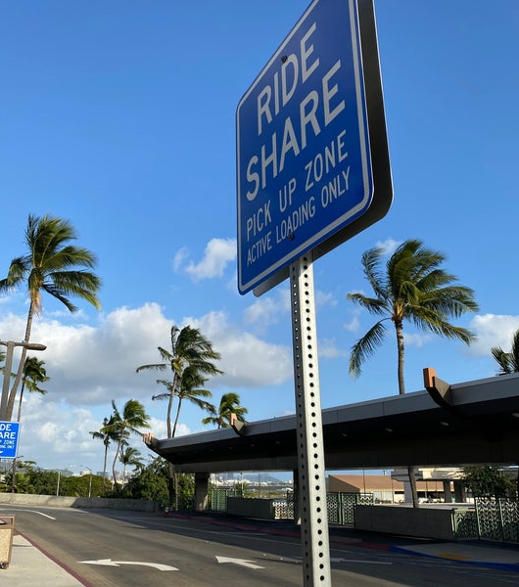
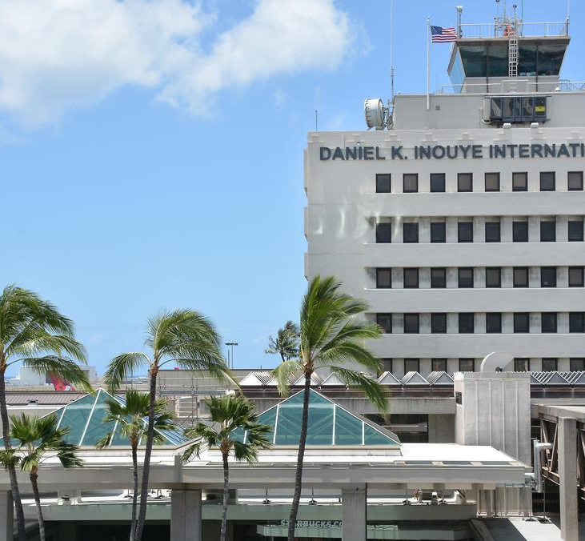
DOT – Commercial Services at Public Airports Rules

Slide 10
DLNR – Manta Ray Rules

Slide 11
How Small Business Can Help the SBRRB
The SBRRB wants to hear from you!
Get involved as rules are being written
Submit a Regulation for Review through the SBRRB website
Submit a Petition for Regulatory Review Chapter 201M-6 HRS

Slide 12
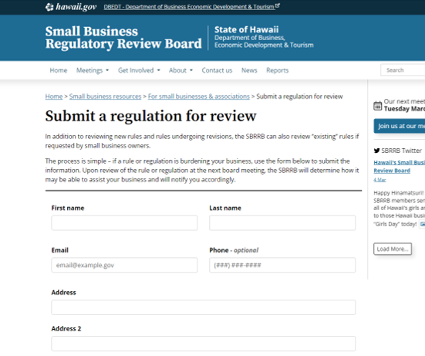
Submit a Regulation for Review

Slide 13
Tools for Small Businesses https://sbrrb.hawaii.gov/
Rule Making Process
Rule Status Tracker
Meeting Dates, Agenda, Minutes & Packet Information
Regulation for Review

Slide 14
How to CONTACT the SBRRB
https://sbrrb.hawaii.gov/
DBEDT.sbrrb.info@hawaii.gov
(808) 798-0737
Visit Monthly SBRRB meetings
Currently, meetings are hybrid via Zoom and at Leiopapa A Kamehameha Building – State Office Tower 235 Beretania Street, Conference Room 405 Honolulu, Hawaii 96813
@SBRRBHI

Slide 15
On Behalf of The Small Business Regulatory Review Board

