Slide 1
Small Business Regulatory Review Board (SBRRB)
Department of Business, Economic Development and Tourism

Slide 2
Why Are Small Businesses Important?
Backbone of U.S. Economy / Federal Act
Establishments with < 100 employees make up 98% of all businesses in Hawaii*
Employees working in small businesses make up 57% of all employees in Hawaii*
Hawaii Ranked:
47th - Overall Top States for Business in 2018**
44th – In Forbes’ Best Ranked States for Business
* Census Bureau’s “County Business Pattern” (CBP) data, 2016
** CNBC.com / Scorecard on State Economic Climate

Slide 3
What is the SBRRB?
SBRRB consists of 11 members:
Volunteers
Advocate for small businesses & entrepreneurs
Small business defined as a “for profit” with fewer than 100 FT/PT employees, Sec. 201M-1, HRS
Authority to comment, make recommendations on small business regulations & administrative rules

Slide 4
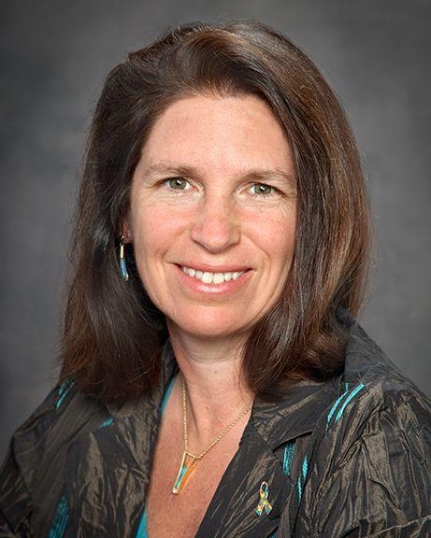
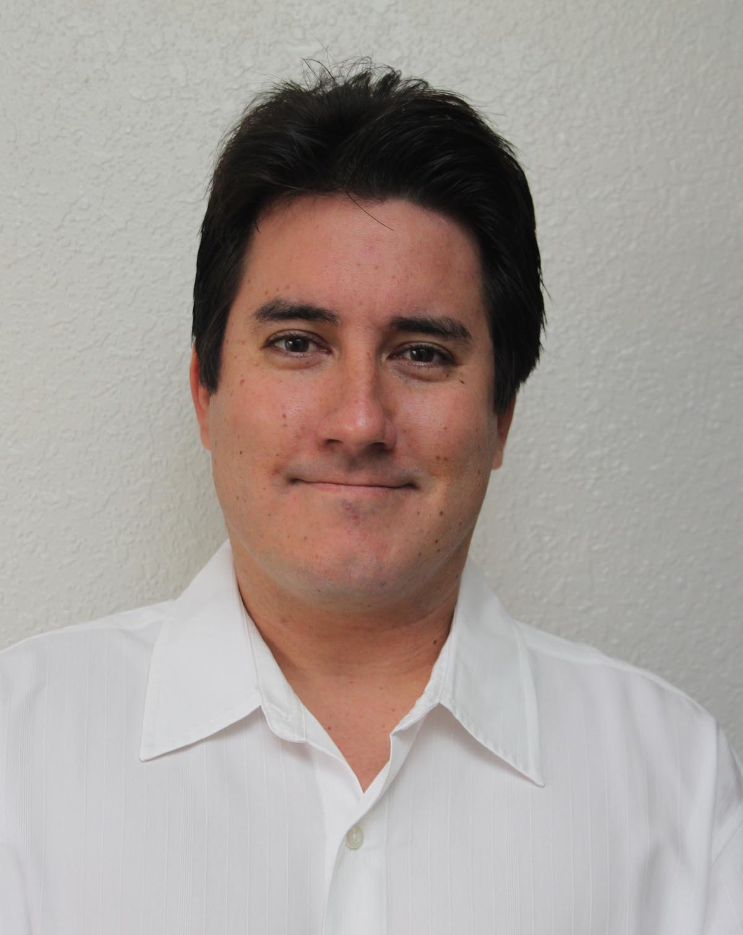
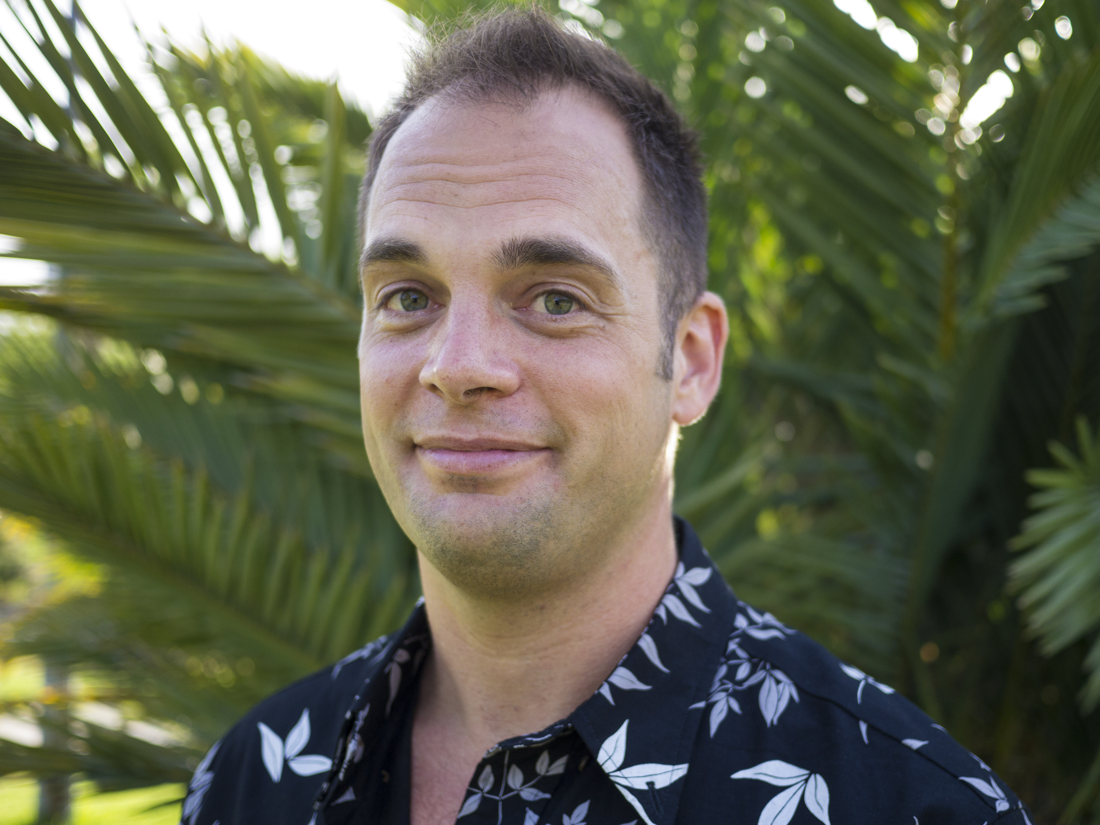
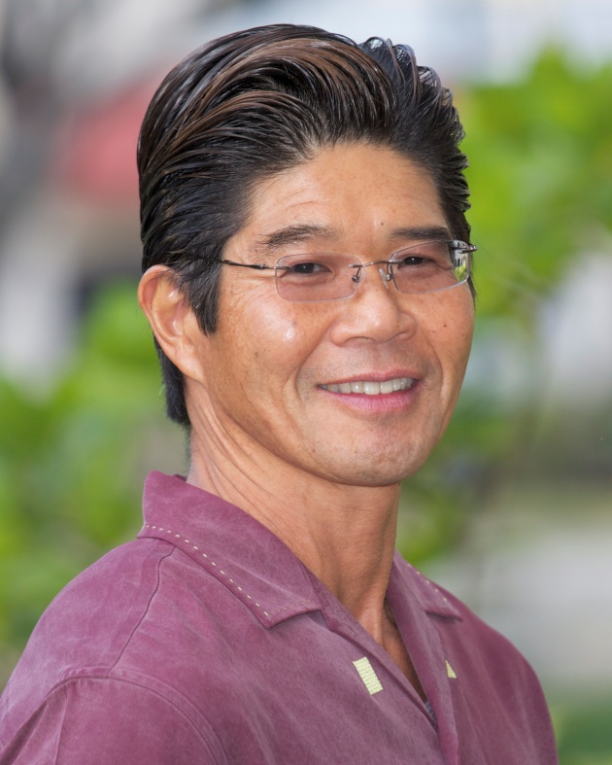
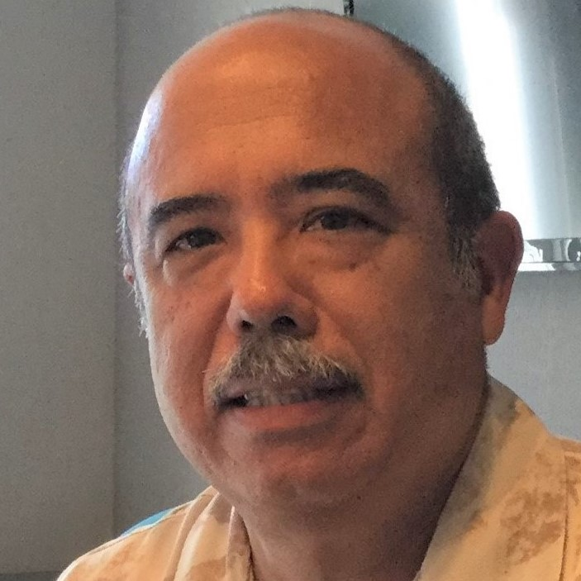
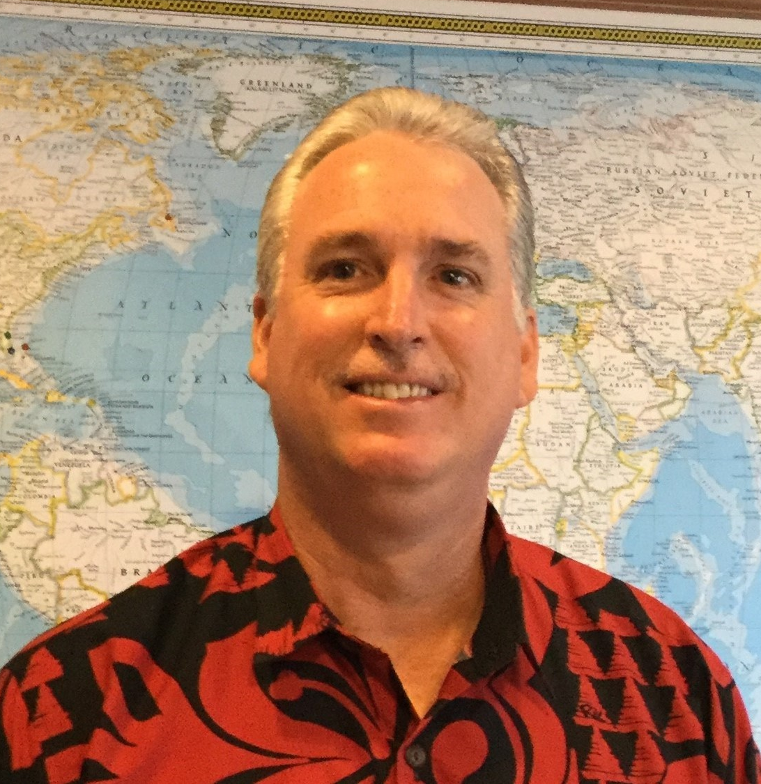
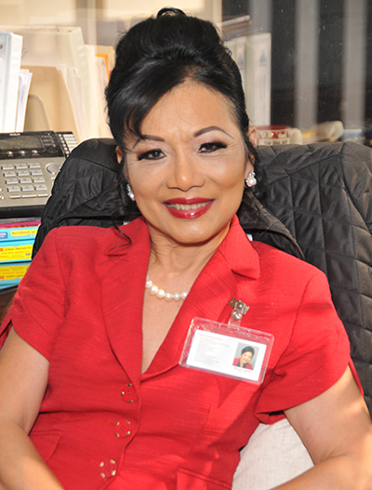
BOARD MEMBERS
DBEDT Director or designated Representative
Mary Albitz
Maui County
William Lydgate
Kaua’i County
Garth Yamanaka
2nd Vice Chair
Hawai’i County
Harris Nakamoto
City & County of Honolulu
Anthony Borge
Chair
City & County of Honolulu
Robert Cundiff
Vice Chair
City & County of Honolulu
Nancy Atmospera-Walch
City & County of Honolulu

Slide 5
SBRRB’s Vision and Mission
Vision
Mission
Make Hawai’i the most business-friendly state in the nation
Work toward a regulatory environment that encourages & supports the vitality of small business in Hawai’i

Slide 6
What Can the SBRRB Do for Small Businesses?
Identify Burdensome Regulations
Recommend modifications to rules that unevenly impose burdens on small business
Work with State and County agencies to avoid unnecessary burdens on small businesses during rule writing
Respond to Small Business Complaints
Regulation Review Card
Petition

Slide 7
Recent Actions Taken by the SBRRB
DOT – Commercial Services at Public Airports
Pilot Program: Uber & Lyft drivers
DLIR - HIOSH Rules
Stakeholder meetings
DOA - Non-Domestic Animal Import Rules
Public Safety / Business impact

Slide 8
How YOU Can Help the SBRRB
The SBRRB wants to hear from you!
Get involved as rules are being written
Identify rules that are especially burdensome / suggest alternatives for compliance with necessary rules
Submit a Regulation Review Card or Petition

Slide 9
How to CONTACT the SBRRB
dbedt.hawaii.gov/sbrrb
Small Business Resources
DBEDT.sbrrb.info@hawaii.gov
(808) 586-2594
Visit Monthly SBRRB meetings
Leiopapa A Kamehameha -State Office Tower, Conference Room 405
235 South Beretania Street Honolulu, HI 96813
@SBRRBHI

